Slide 1
A MODULAR AGRICULTURE SYSTEM
Ahsan Ashraf, Muhammad Haziq Saleem & Muhammad Saad Wasif
2nd Year, Electrical Engineering – NEDUET
October 12th 2018
Notes:
We designed this template so that each member of the project team has a set of slides with its own theme. Members, here’s how you add a new slide to just your set:
Mark where you want to add the slide: Select an existing one in the Thumbnails pane, click the New Slide button, then choose a layout. The new slide gets the same theme as the other slides in your set.
Careful! Don’t annoy your fellow presenters by accidentally changing their themes. That can happen if you choose a different theme from the Design tab, which changes all of the slides in the presentation to that look.

Slide 2
Table Of Contents
Goal of the Project
What is Precision Agriculture
Precision Irrigation
Innovative Technologies In Agriculture
Project Description
System Block Diagram
System Explanation
Test Readings
Graphical User Interface
Timeline

Slide 3
Goal of the project
Improving efficiency of water usage through better farm practices and well maintained and expanded irrigation infrastructure.

Slide 4
What is Precision Agriculture?
Precision Agriculture (PA) is the application of IoT (Internet of Things) in agriculture. The basic purpose of using Precision Agriculture is to treat the crops precisely according to their needs thus avoiding the wastage of resources and increasing yield, sustainability and productivity of crops.

Slide 5
Precision Irrigation
It is a sub-domain of Precision Agriculture.
Crop Irrigation requirements may vary with changing environment. Precision Irrigation provides means for evaluating crop’s water requirements and means for applying the right amount of water at the right time.

Slide 6
Innovative Technologies In Irrigation
Drip Irrigation
Micro – Spray Irrigation
Low- Energy precision application of sprinklers
Recycling and Treatment of wastewater

Slide 7
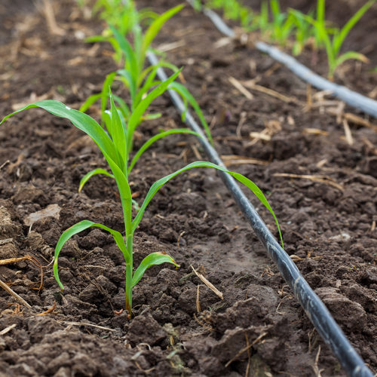
Drip Irrigation

Slide 8
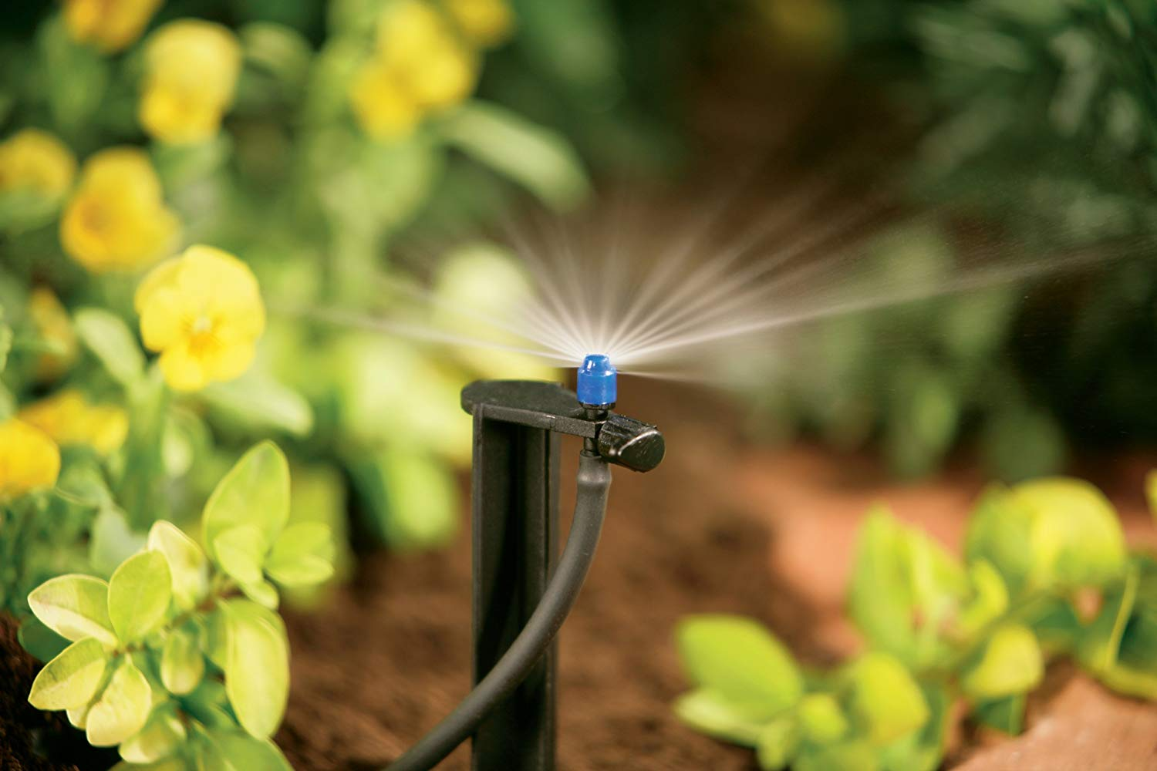
Micro – Spray Irrigation

Slide 9
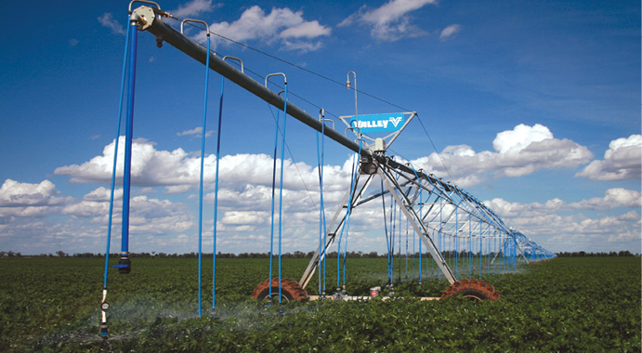
Low- Energy precision application of sprinklers

Slide 10
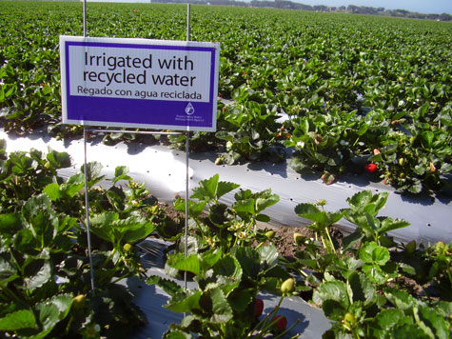
Recycling and Treatment of wastewater

Slide 11
Project Description
In our project we aim at remotely monitoring the crops and using precise drip irrigation method.
This is done by electronically controlling a water valve (based on the readings from various sensors in the field).
Sensor data is also logged in a database and shown graphically on a website.

Slide 12
System Block Diagram
User Interface
Database
Probe
Probe
Probe
Server
Field
Hub
Water Valve

Slide 13
Probe
Probes are installed in the field. It is the platform which contains all the sensors and a microcontroller.
The sensors are connected to a microcontroller board “LoRaduino”.
This collected data is processed in LoRaduino.
Processed data is transmitted to the communication hub through a built-in radio transmitter.

Slide 14
Probe Block Diagram
µController(ATMEGA328P)
Soil Temperature Sensor
Humidity Sensor (DHT11)
Photoresistor
LoRa RF-95 Wireless Transmitter
Moisture Sensor
LoRaduino

Slide 15
Communication Hub
It is situated in the field (within the distance range of the probes’ radio transmitter).
Communication Hub also contains a LoRaduino microcontroller.
Built-in radio receiver is used to receive data from the probes which are transmitting data from the field.
A Wi-Fi module is connected to LoRaduino.
Sensor data is sent to the database by using the Wi-Fi Module.

Slide 16
Hub Block Diagram
RF-Wireless Receiver
NodeMCU
µController(ATMEGA328P)
LoRaduino

Slide 17

Water Valve
It contains a solenoid water valve which is controlled by a relay.
The hub’s microcontroller(based upon sensor values/based upon time intervals) switches the relay on/off.
Hub
Water Valve

Slide 18
Database
For the purpose of this project we are using MySQL database management system based on SQL database language to store our data transmitted from communication hub
Wi-Fi Module (ESP8266) in communication hub is transmitting readings of different probes to MySQL Database which is then used by User Interface for analysis purpose.

Slide 19
User Interface
In order to display analyzed data we need a user interface that is a website which displays separate graphs of Temperature, Humidity and Moisture with respect to time.
Also it will display the current values of these three parameters in each probe.
Future predictions can be made after analysis of collected data from probe.

Slide 20
Block Diagram Of User Interface
MySQL
Python
JavaScript
Database
Backend
Charts
Frontend
HTML/CSS

Slide 21
Test Readings
Condition Of Soil | Value of Moisture | Soil Temperature | Atmosphere Temperature | Humidity
Dry | 0 | 30 | 30 | 52
Medium | 60 | 27 | 30 | 52
Wet | 80 | 27 | 30 | 52

Slide 22
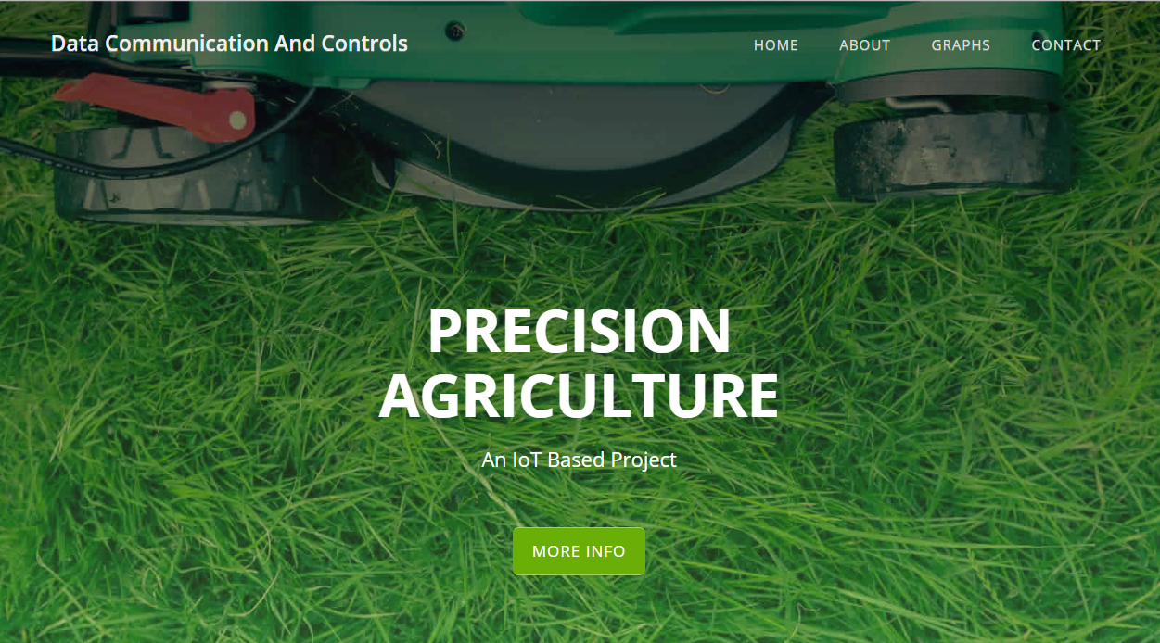
Website Interface

Slide 23
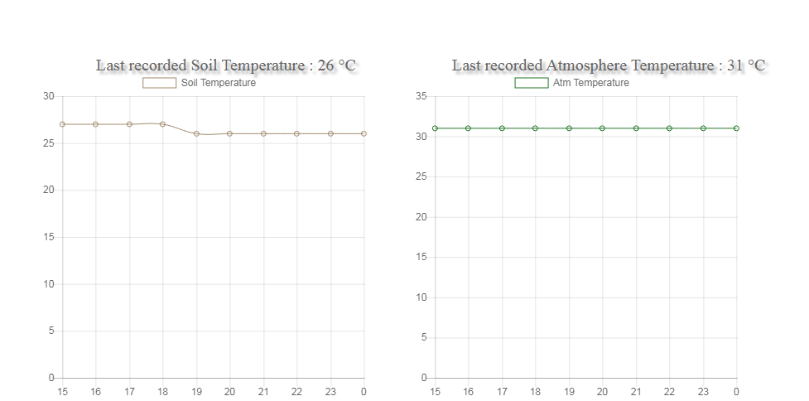
Website Interface

Slide 24
Timeline
Week-1: Introduction and Study of Embedded Systems
Week-2: Study of Internet of Things (IoT), Precision Agriculture and Project Planning
Week-3: Development
Week 4: Testing & Debugging
Week 5: Conclusion, Demo & Presentation

Slide 25
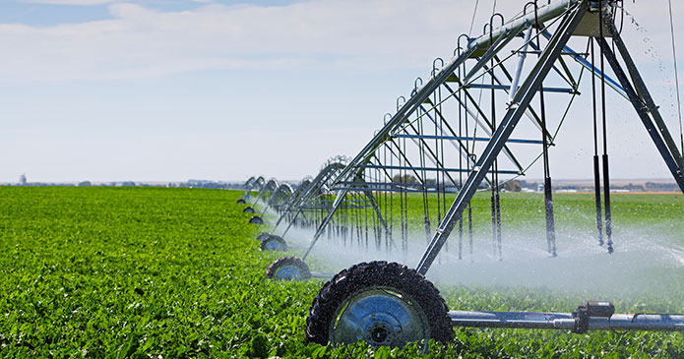
Thank You.
“We never know the worth of water till the well is dry.”
Save Water!!

